Slide 1
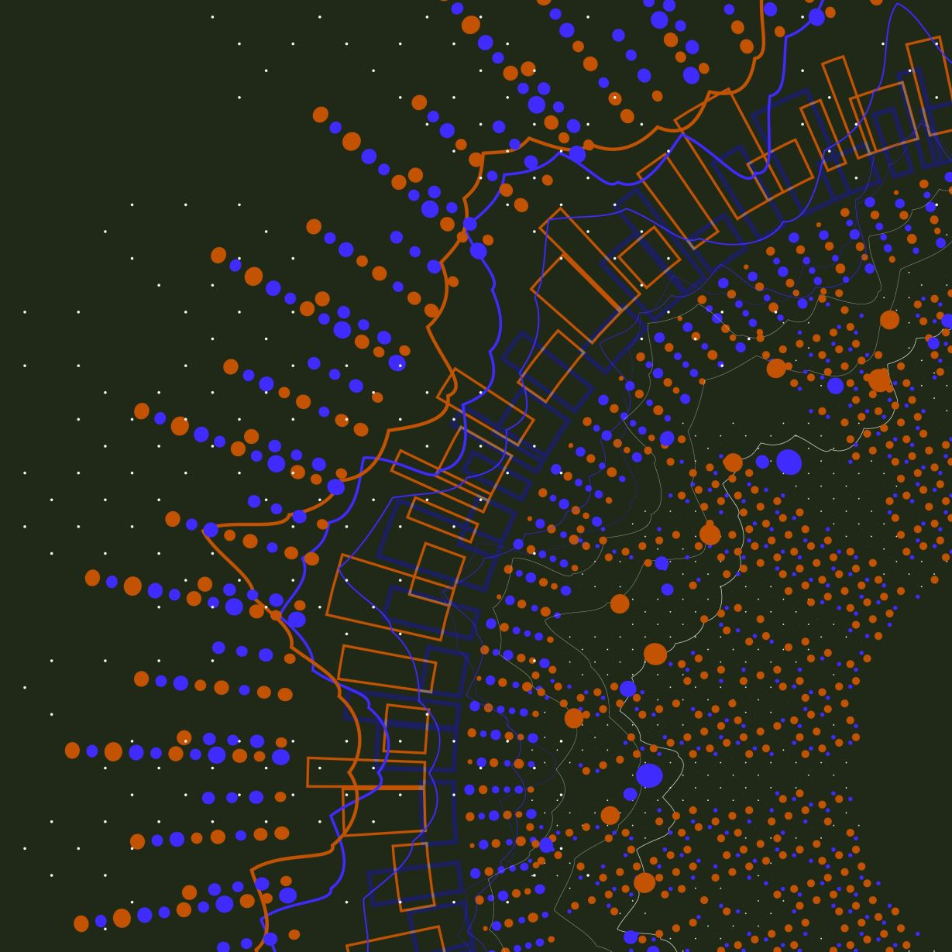
Team Dynamics
Team 5
Khaled Masoud
Farouq Hassan
Ahmad Arqoub
Firas Tamimi
Jana Abu-RummAn

Slide 2
Learning outcomes
LO1- be able to Explain and define team dynamic.
LO2- What makes a team dynamic.
LO3- Identify strategies for building effective teams.

Slide 3
Headings
What Is A Team?
What Are Team Roles?
What Are Characteristics Of Teams?
What Is Team Dynamics?
Why Do You Need to Consider Team Dynamics?
What Are Team Dynamics Types?
What Are Action Oriented Roles?
What Are Thinking Oriented Roles?
What Are People Oriented Roles?
How To Develop Your Team Dynamics?
Activity Sheet.

Slide 4
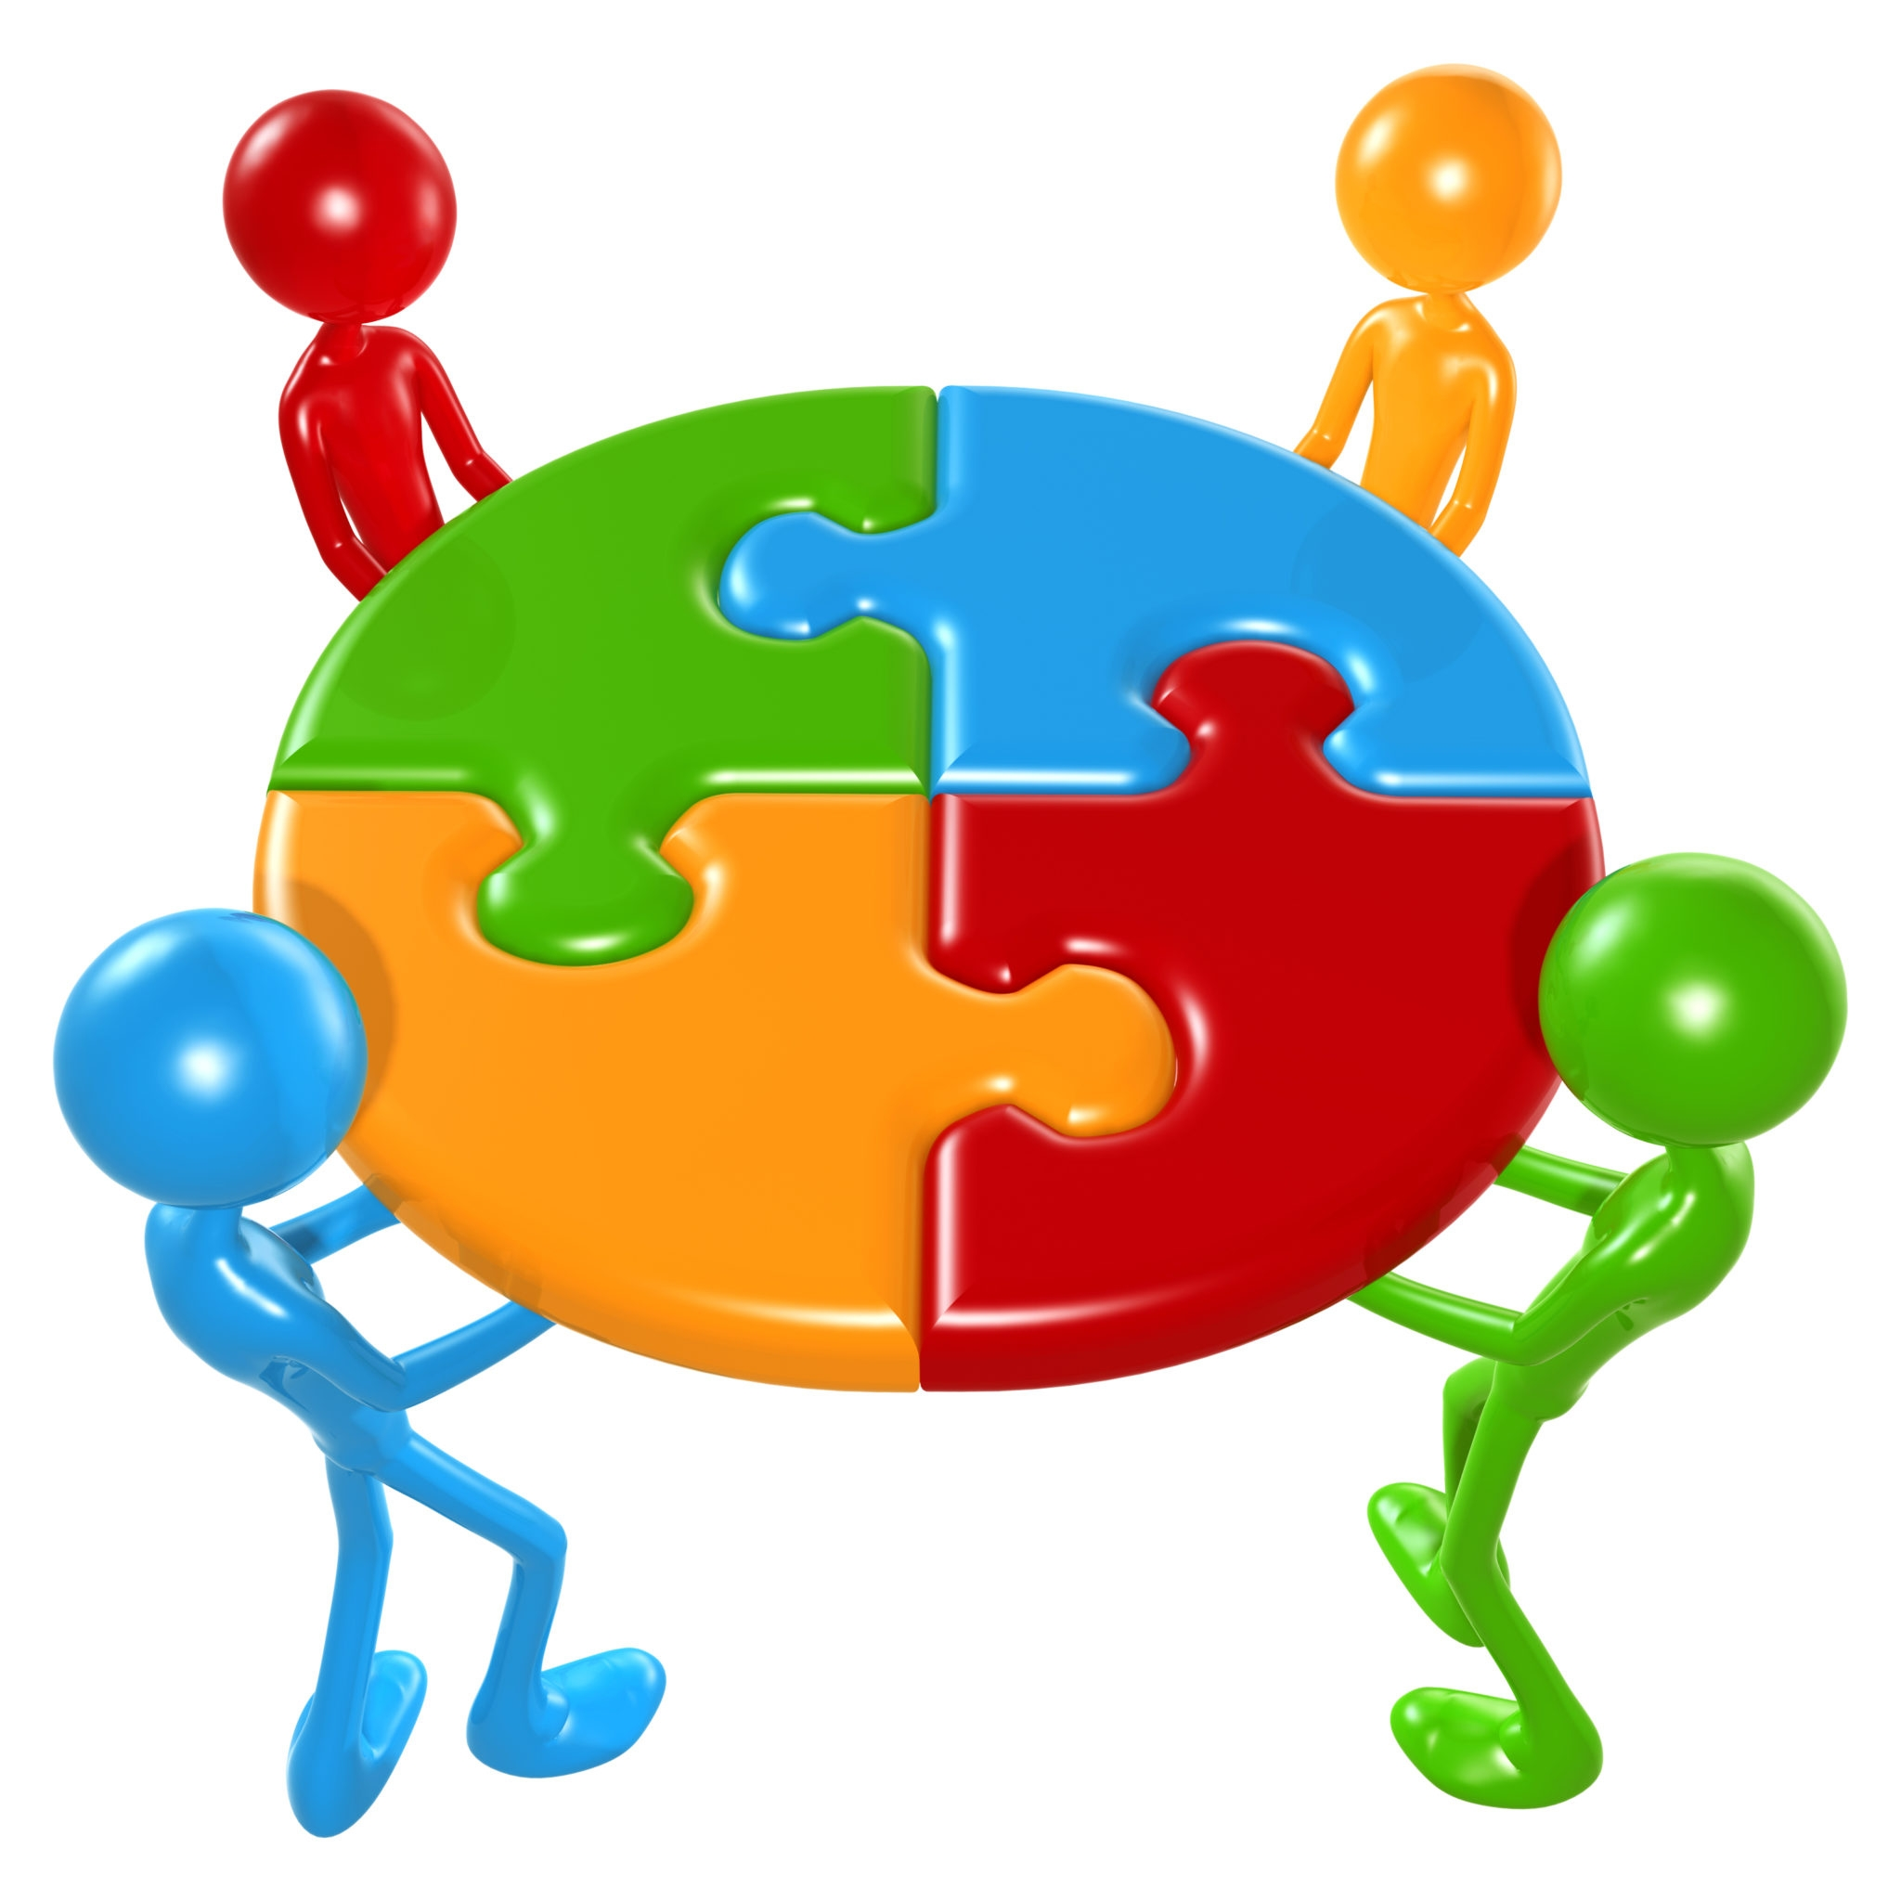
What is a Team?
A team is a group of people who perform one or more interrelated tasks to work towards a specific goal or common task. By sharing the necessary skills for each of them.

Slide 5
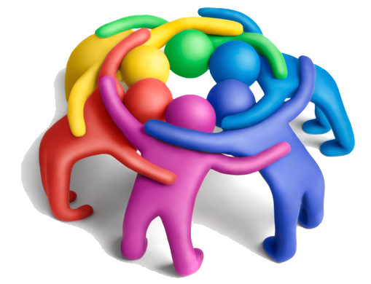
Characteristics of a team
1. Clearly defined goals 2. Clearly defined roles
3. Team rules 4. Open communication
5. Team trust
Notes:
1. Clearly defined goals: the successful team accepts project and company goals, and the leader need to be sure that all the members have got all the objectives and goals and have communicated openly and without nebulously.
2. Clearly defined roles: every member of the team must have a specific mission, and all the members should respect every other role.
3. Team rules: it must be there specific roles and had to put it and implement them from the first.
4. Open communication: The role of the leader is to promote a secure environment for open communication, so they are encouraged to share opinions and ideas and discuss progress.
5. Team trust: the last point encourages trust as much as loyalty in the team, so everyone in the team needs to know that everything that happens in the team stays in the team.

Slide 6
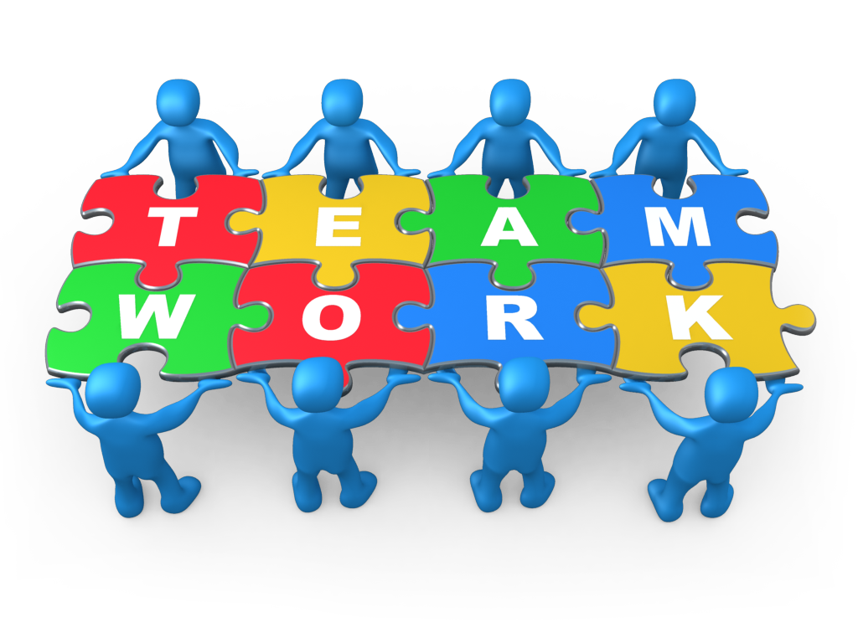
Team Dynamics
The behavioral interactions between team members are referred to as team dynamics. The effectiveness of a team in achieving its objectives is significantly influenced by how well it works together, interacts, and communicates.

Slide 7
Why do we need to consider team dynamics?
Team dynamics allows us to complete tasks that are complicated and difficult for individuals to complete on their own.
Team dynamics focuses on the variety of skills and abilities each team member has.

Slide 8
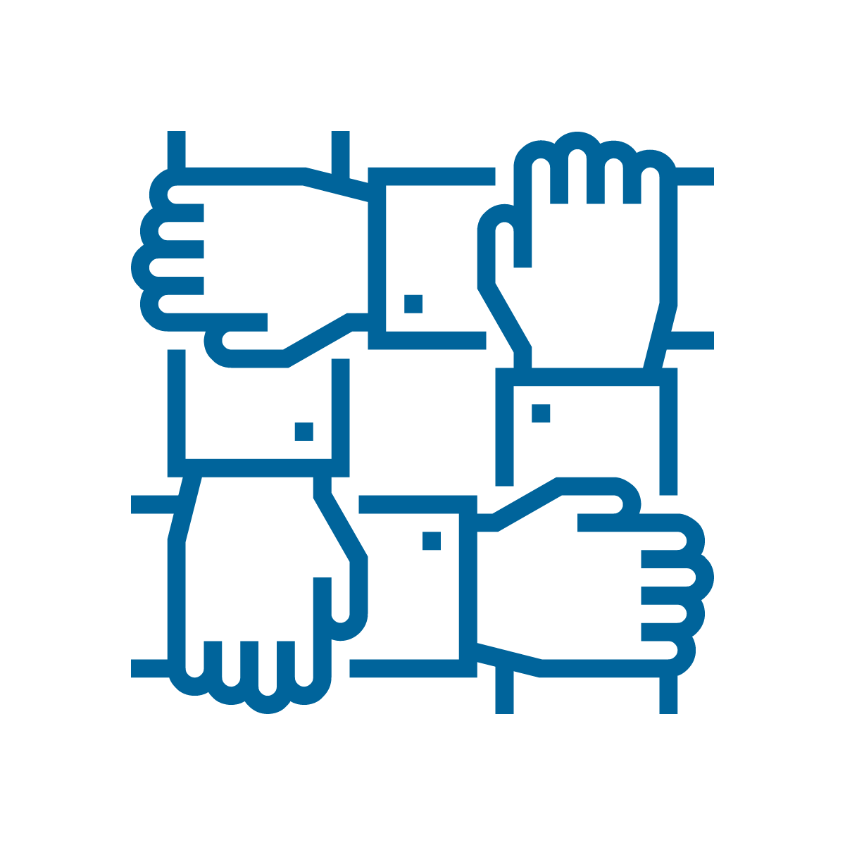


How to improve team dynamics?
Mutual respect between team members should be maintained.
Always have the winning mentality, that is what teamwork is about.
3. Flexibility.

Slide 9
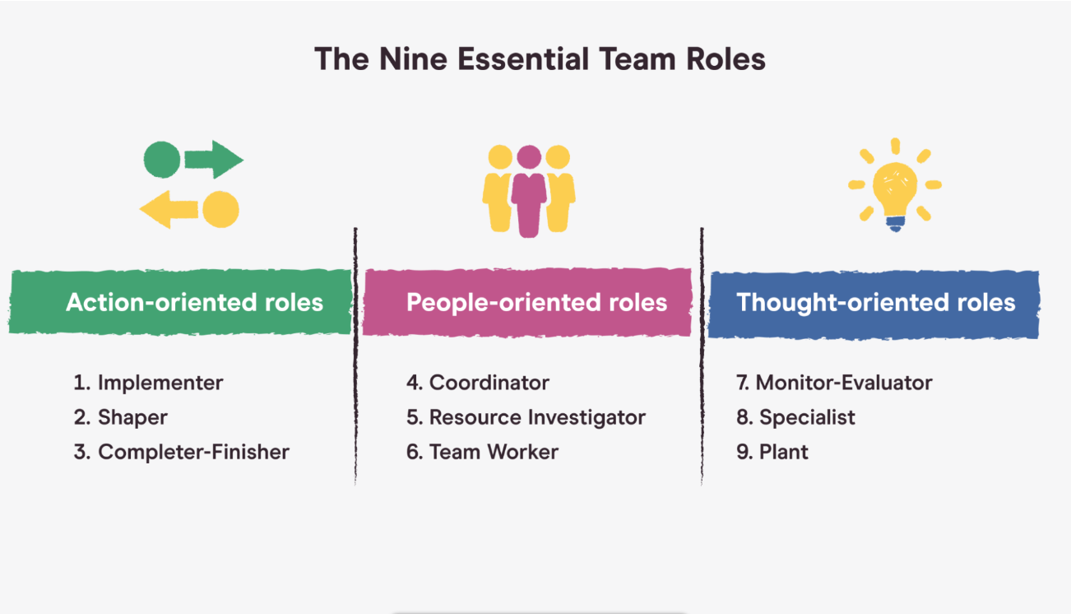
What are team roles?

Slide 10
Action-oriented roles:
1- Implementer. 2- completer finisher. 3- shaper.
Notes:
1- Implementer: A person who gets the work done.
2- Completer finisher: A person who really focuses on detail.
3- Shaper: A person who motivates others to get the work done.

Slide 11
Thinking-oriented roles:
1- Specialist. 2- Plant. 3- Monitor.
Notes:
Specialist: Someone with relevant experience who possesses a particular talent that will help the project
Plant: a person who has critical thinking (Out of box thinker).
Monitor: A person who is good at analyzing ideas

Slide 12
People-oriented roles:
1- Team worker.
2- Resource Investigator.
3- Coordinator.
Notes:
1. Team worker: A person who supports others, and he loves to help everyone
2. Resource Investigator: A person who searches for options and information. And give the team more details.
3. Coordinator: The biggest advantage of this person is that he is an excellent leader

Slide 13
How to develop your team dynamics?
Forming
Storming
Norming
Performing
Adjourning
Notes:
After facing some problems in our team we had to learn more about team’s dynamics which led us into thinking about ways to improve our team dynamics, and here are some of the efficient ways:
Forming: The first step we took was to know the capabilities and skills of our team members so that we could assign tasks and roles to each of us after we had worked to understand and define our goals in our project.
Storming: This step is intended to reduce conflicts that we may encounter when expressing our different opinions about our project
Norming: Here, in this step, the team begins to accomplish the tasks in a large and elaborate manner, after the team members have understood their various tasks and realized their main goal.
Performing: The team is making great progress at this point due to the synergy between Team members work independently and trust each other, and Roles begin to become more flexible
Adjourning: The last step before we say goodbye to the team members, the team members make sure that all the remaining work is completed and presented in the best way. They make time to celebrate their achievements and begin to mention the contributions of everyone.

Slide 14
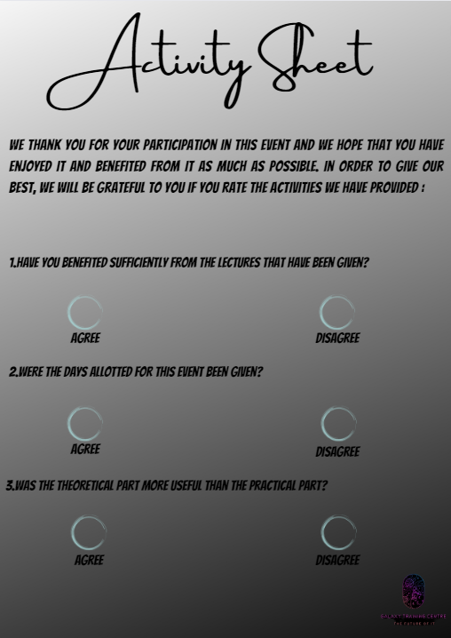

Slide 15

Thank you for paying attention

Slide 16
References
Professional Practice Power Points on Teams
2022. [online] Available at: <https://recruitee.com/articles/effective-teams> [Accessed 13 September 2022].
Development, 5., 2022. 5 Stages of Team Development. [online] Toggl.com. Available at: <https://toggl.com/track/stages-of-team-development/#:~:text=What%20are%20the%205%20stages,have%20a%20knack%20for%20rhyming.> [Accessed 13 September 2022].
2022. [online] Available at: <https://www.belbin.com/about/belbin-team- roles#:~:text=The%20nine%20Belbin%20Team%20Roles%20are%3A%20Resource%20Investigator %2C%20Teamworker%20and,about%20each%20Team%20Role%20below> [Accessed 13 September 2022].

